Slide 1
Predictive Analytics

Slide 2
Session Objectives
Give a quick introduction to predictive analytics
Introduction to classification problem using decision tree learning
Hands-on Lab: Building a decision tree classifier

Slide 3
Some Applications

Slide 4
Family and Personal Life
Location: Microsoft and Nokia predict future location based on cellular phone and location data.
Friendship and connection: Facebook and LinkedIn
Love:
Match.com: Predict potential matches
OkCupid: Which message content is most likely to elicit a response
Pregnancy: Target predicts customer pregnancy
Divorce and infidelity: University and clinical researcher can predict this as well!

Slide 5
Direct Marketing
Cox Communication: Tripled direct mail responses by predicting propensity to buy
Harrah’s Las Vegas: The casino predicts how much a customer will spend over the long term
Target: Increased revenue 15-30 percent with predictive models
PREMIER Bankcard: Reduced mailing cost by $12 million

Slide 6
Telcos, Retail and More
Fedex: predicts defection to a competitor with 65-90% accuracy
Telcos: Optus (Australia), Sprint, Telenor(Norway), 2degrees (New Zealand)
Amazon: 35% sales come from product recommendation

Slide 7

Even In Law Enforcement….
Notes:
http://www.dataminingcourse.net/analytics-in-law-enforcement/
Mention the name of the startups in this space. Predictive policing etc.

Slide 8
Decision trees

Slide 9
Classification: Definition
Given a collection of records (training set)
Each record contains a set of attributes, one of the attributes is the class.
Find a model for one of the class attributes as a function of the values of other attributes.
Goal: previously unseen records should be assigned a class as accurately as possible.
A test set is used to determine the accuracy of the model. Usually, the given data set is divided into training and test sets, with training set used to build the model and test set used to validate it.
Notes:
Explain in plain words.
There are other issues like having a blind validation set, calibration set and test set. I do not plan to discuss these here.

Slide 10
Illustrating Classification Task
Notes:
A model is really a data and/or binary file.

Slide 11
Examples of Classification Task
Marketing: Customer churn
Online: Bot detection in web traffic
Medical: Predicting tumor cells as benign or malignant
Finance: Credit card fraud detection
Document Classification: Categorizing news stories as finance, weather, entertainment, sports, etc.
Security/Surveillance: Face and fingerprint recognition

Slide 12
Decision Tree classification
categorical
categorical
continuous
class
Splitting Attributes
Refund
Yes
No
NO
MarSt
Single, Divorced
Married
TaxInc
NO
< 80K
> 80K
NO
YES
Training Data
Model: Decision Tree
Notes:
This is the model built using decision tree learning.

Slide 13
A different Decision Tree
MarSt
Single, Divorced
categorical
categorical
continuous
class
Married
NO
Refund
Yes
No
NO
TaxInc
< 80K
> 80K
NO
YES
There could be more than one tree that fits the same data!
Notes:
Discuss the difference in decision tree

Slide 14
Decision Tree Classification Task
Decision Tree
Notes:
You will hear ‘model’ in the common jargon. This is what a model is.

Slide 15
Apply Model to Test Data
Start from the root of tree.
Test Data
Refund
Yes
No
NO
MarSt
Single, Divorced
Married
TaxInc
NO
< 80K
> 80K
NO
YES
Notes:
How do we use the model to classify?

Slide 16
Apply Model to Test Data
Test Data
Refund
Yes
No
NO
MarSt
Single, Divorced
Married
TaxInc
NO
< 80K
> 80K
NO
YES

Slide 17
Apply Model to Test Data
Test Data
Refund
Yes
No
NO
MarSt
Single, Divorced
Married
TaxInc
NO
< 80K
> 80K
NO
YES

Slide 18
Apply Model to Test Data
Test Data
Refund
Yes
No
NO
MarSt
Single, Divorced
Married
TaxInc
NO
< 80K
> 80K
NO
YES

Slide 19
Apply Model to Test Data
Test Data
Refund
Yes
No
NO
MarSt
Single, Divorced
Married
TaxInc
NO
< 80K
> 80K
NO
YES

Slide 20
Apply Model to Test Data
Test Data
Refund
Yes
No
NO
MarSt
Single, Divorced
Married
Cheat = “No”
TaxInc
NO
< 80K
> 80K
NO
YES
Notes:
We did not need to even look at the taxable income according to this model.

Slide 21
Decision Tree Classification Task
Decision Tree

Slide 22
How do we get a tree
Exponentially many decision trees are possible
Finding the optimal tree is infeasible
Greedy methods that find sub-optimal solutions do exist
Notes:
Some trees are better than other trees.

Slide 23
Decision Tree Induction
Hunt’s Algorithm (one of the earliest). Basis for many decision tree induction algorithms
CART
ID3
C4.5

Slide 24
Hunt’s Algorithm
Let D_{t} be the set of training records that reach a node t
General Procedure:
If D_{t} contains records that belong to the same class y_{t}, then t is a leaf node labeled as y_{t}
If D_{t} is an empty set, then t is a leaf node labeled by the default class, y_{d}
If D_{t} contains records that belong to more than one class, use an attribute test to split the data into smaller subsets. Recursively apply the procedure to each subset.
D_{t}

Slide 25
Hunt’s Algorithm
Refund
Don’t
Cheat
Yes
No
Don’t
Cheat
Don’t
Cheat
Refund
Refund
Yes
No
Yes
No
Don’t
Cheat
Marital
Status
Don’t
Cheat
Marital
Status
Single,
Divorced
Single,
Divorced
Married
Married
Cheat
Don’t
Cheat
Taxable
Income
Don’t
Cheat
< 80K
>= 80K
Don’t
Cheat
Cheat

Slide 26
Tree Induction
Greedy strategy
Split the records based on an attribute test that optimizes certain criterion
Issues
Determine how to split the records
How to specify the attribute test condition?
How to determine the best split?
Determine when to stop splitting

Slide 27
Tree Induction
Greedy strategy.
Split the records based on an attribute test that optimizes certain criterion.
Issues
Determine how to split the records
How to specify the attribute test condition?
How to determine the best split?
Determine when to stop splitting

Slide 28
How to Specify Test Condition?
Depends on attribute types
Nominal
Ordinal
Continuous
Depends on number of ways to split
2-way split
Multi-way split

Slide 29
Splitting on Nominal Attributes
Multi-way split: Use as many partitions as distinct values.
Binary split: Divides values into two subsets. Need to find optimal partitioning.
Car Type
Family
Luxury
Sports
Car Type
OR
Car Type
{Sports, Luxury}
{Family, Luxury}
{Family}
{Sports}

Slide 30
Splitting on Ordinal Attributes
Multi-way split: Use as many partitions as distinct values.
Binary split: Divides values into two subsets. Need to find optimal partitioning.
What about this split?
Size
Small
Large
Medium
Size
Size
{Small, Medium}
OR
{Medium, Large}
{Large}
{Small}
Size
{Small, Large}
{Medium}

Slide 31
Splitting on Continuous Attributes
Different ways of handling
Discretization to form an ordinal categorical attribute
Static – discretize once at the beginning
Dynamic – ranges can be found by equal interval bucketing, equal frequency bucketing (percentiles), or clustering.
Binary Decision: (A < v) or (A ≥ v)
Consider all possible splits and finds the best cut
Can be more compute intensive

Slide 32
Splitting on Continuous Attributes

Slide 33
Tree Induction
Greedy strategy
Split the records based on an attribute test that optimizes certain criterion
Issues
Determine how to split the records
How to specify the attribute test condition?
How to determine the best split?
Determine when to stop splitting

Slide 34
How to determine the Best Split
Before Splitting: 10 records of class 0, 10 records of class 1
Which test condition is the best?
Notes:
What is wrong with student id?

Slide 35
How to determine the Best Split
Greedy approach:
Nodes with homogeneous class distribution are preferred
Need a measure of node impurity:
Non-homogeneous
High degree of impurity
Homogeneous
Low degree of impurity

Slide 36
Measures of Node Impurity
Gini Index
Entropy
Misclassification error

Slide 37
How to Find the Best Split
Before Splitting:
M0
A?
B?
Yes
No
Yes
No
Node N1
Node N2
Node N3
Node N4
M1
M2
M3
M4
M12
M34
Gain = M0 – M12 vs M0 – M34

Slide 38
Measure of Impurity: GINI
Gini Index for a given node t :
(NOTE: p( j | t) is the relative frequency of class j at node t).
Maximum (1 - 1/n_{c}) when records are equally distributed among all classes, implying least interesting information
Minimum (0.0) when all records belong to one class, implying most interesting information

Slide 39
Examples for computing GINI
P(C1) = 0/6 = 0 P(C2) = 6/6 = 1
Gini = 1 – P(C1)² – P(C2)² = 1 – 0 – 1 = 0
P(C1) = 1/6 P(C2) = 5/6
Gini = 1 – (1/6)² – (5/6)² = 0.278
P(C1) = 2/6 P(C2) = 4/6
Gini = 1 – (2/6)² – (4/6)² = 0.444

Slide 40
Splitting Based on GINI
Used in CART, SLIQ, SPRINT.
When a node p is split into k partitions (children), the quality of split is computed as:
where, n_{i} = number of records at child i,
n = number of records at node p.

Slide 41
Binary Attributes: Computing GINI Index
Splits into two partitions
Effect of Weighing partitions:
Larger and Purer Partitions are sought after
B?
Yes
No
Node N1
Node N2
Gini(N1) = 1 – (5/6)² – (2/6)² = 0.194
Gini(N2) = 1 – (1/6)² – (4/6)² = 0.528
Gini(Children) = 7/12 * 0.194 + 5/12 * 0.528 = 0.333

Slide 42
Alternative Splitting Criteria - Entropy
Entropy at a given node t:
(NOTE: p( j | t) is the relative frequency of class j at node t).
Measures homogeneity of a node.
Maximum (log n_{c}) when records are equally distributed among all classes implying least information
Minimum (0.0) when all records belong to one class implying most information
Entropy based computations are similar to the GINI index computations

Slide 43
Examples for computing Entropy
P(C1) = 0/6 = 0 P(C2) = 6/6 = 1
Entropy = – 0 log 0 – 1 log 1 = – 0 – 0 = 0
P(C1) = 1/6 P(C2) = 5/6
Entropy = – (1/6) log₂ (1/6) – (5/6) log₂ (1/6) = 0.65
P(C1) = 2/6 P(C2) = 4/6
Entropy = – (2/6) log₂ (2/6) – (4/6) log₂ (4/6) = 0.92

Slide 44
Splitting Based on INFO...
Information Gain:
Parent Node, p is split into k partitions;
n_{i} is number of records in partition i
Measures Reduction in Entropy achieved because of the split. Choose the split that achieves most reduction (maximizes GAIN).
Used in ID3 and C4.5
Disadvantage: Tends to prefer splits that result in large number of partitions, each being small but pure.

Slide 45
Splitting Based on INFO...
Gain Ratio:
Parent Node, p is split into k partitions
n_{i} is the number of records in partition i
Adjusts Information Gain by the entropy of the partitioning (SplitINFO). Higher entropy partitioning (large number of small partitions) is penalized!
Used in C4.5
Designed to overcome the disadvantage of Information Gain

Slide 46
Splitting Criteria based on Classification Error
Classification error at a node t :
Measures misclassification error made by a node
Maximum (1 - 1/n_{c}) when records are equally distributed among all classes, implying least interesting information
Minimum (0.0) when all records belong to one class, implying most interesting information

Slide 47
Examples for Computing Error
P(C1) = 0/6 = 0 P(C2) = 6/6 = 1
Error = 1 – max (0, 1) = 1 – 1 = 0
P(C1) = 1/6 P(C2) = 5/6
Error = 1 – max (1/6, 5/6) = 1 – 5/6 = 1/6
P(C1) = 2/6 P(C2) = 4/6
Error = 1 – max (2/6, 4/6) = 1 – 4/6 = 1/3

Slide 48
Tree Induction
Greedy strategy
Split the records based on an attribute test that optimizes certain criterion
Issues
Determine how to split the records
How to specify the attribute test condition?
How to determine the best split?
Determine when to stop splitting

Slide 49
Stopping Criteria for Tree Induction
Stop expanding a node when all the records belong to the same class
Stop expanding a node when all the records have similar attribute values
Early termination

Slide 50
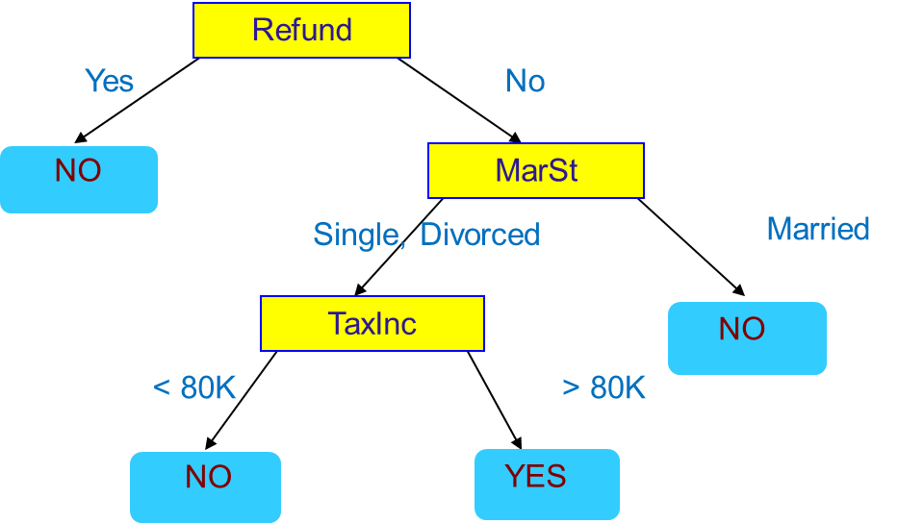
Decision Trees - PROS
Intuitive: Easy interpretation for small trees
Non parametric: Easy to incorporate both numeric and categorical data
Fast: Once the rules are developed, prediction (classification or regression) is fast
Robust to outliers: The technique is largely robust to outliers
Notes:
Not an exhaustive list.

Slide 51
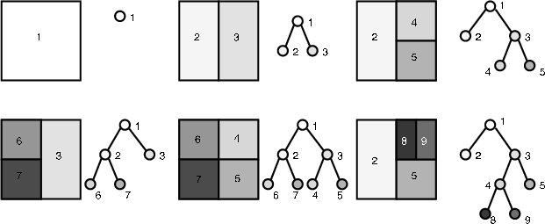
Decision Trees - CONS
Overfitting: Tend to over fit if not trained with care
Rectangular Classification: One field at a time; recursive partitioning of data
Tree replication: A tree may be replicated again

Slide 52
RPART – Kyphosis Data
81 rows and 4 columns
Representing data on children who have had corrective spinal surgery
Kyphosis a factor with levels absent/present indicating if a kyphosis (a type of deformation) was present after the surgery
Age (in months)
Number the number of vertebrae involved
Start the number of the ﬁrst (topmost) vertebra operated on
Kyphosis Age Number Start
absent 71 3 5
absent 158 3 14
present 128 4 5
absent 2 5 1
absent 1 4 15
absent 1 2 16
absent 61 2 17
absent 37 3 16

Slide 53
RPART ON IRIS DATA – Test TRAIN SPLIT
sub <- c(sample(1:50, 25), sample(51:100, 25), sample(101:150, 25))

Slide 54
RPART ON IRIS DATA – training the model
fit <- rpart(Species ~ ., data = iris, subset = sub)

Slide 55
RPART ON IRIS DATA – PREDICTING
predict(fit, iris[-sub,])
predict(fit, iris[-sub,], type = "class")

Slide 56
RPART ON IRIS DATA – Confusion Matrix
table(predict(fit, iris[-sub,], type = "class"), iris[-sub, "Species"])
setosa versicolor virginica
setosa 25 0 0
versicolor 0 24 4
virginica 0 1 21

Slide 57
SPLITTING INTO TRAIN AND TEST RANDOMLY
splitdf <- function(dataframe, seed=NULL)
{
if (!is.null(seed)) set.seed(seed)
index <- 1:nrow(dataframe)
trainindex <- sample(index, trunc(length(index)/2))
trainset <- dataframe[trainindex, ]
testset <- dataframe[-trainindex, ]
list(trainset=trainset,testset=testset)
}

Slide 58
RPART
fit <- rpart(Kyphosis ~ Age + Number + Start, data = kyphosis)
fit2 <- rpart(Kyphosis ~ Age + Number + Start, data = kyphosis,
parms = list(prior = c(0.65, 0.35), split = "information"))
fit3 <- rpart(Kyphosis ~ Age + Number + Start, data=kyphosis,
control = rpart.control(cp = 0.05))
par(mfrow = c(1,2), xpd = TRUE)
plot(fit)
text(fit, use.n = TRUE)
plot(fit2)
text(fit2, use.n = TRUE)

Slide 59
Rpart package
http://www.statmethods.net/advstats/cart.html
>rpartFormula = paste("V15~",paste(paste("V",1:14, sep=""),collapse="+"),sep="")
>str(adult)
> model = rpart(rpartFormula,data=adult,method="class")
> str(model)
> plot(model)
> text(model)
Prettier plots with Rpart
http://tagteam.harvard.edu/hub_feeds/1981/feed_items/207424

